Slide 1
How to Fail at Grad School
John S. Costello
B.A., Carleton ’95
Drop-out, University of Arizona ’04

Slide 2
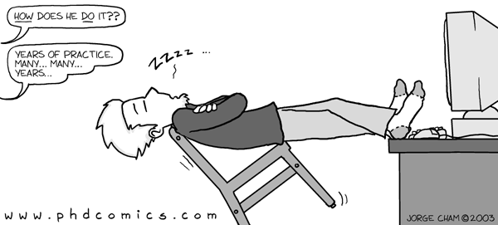
There is a dearth of resources for the aspiring grad school failure
http://www.phdcomics.com does not count as a “resource”!

Slide 3
You are surrounded by success
Your professors all succeeded in grad school
(Exception: Anya Dotlibova)
It’s hard to learn about failure by studying success
Heck, it’s hard to learn about success by studying success!

Slide 4
Success is idiosyncratic; Failure is universal
« Все счастливые семьи похожи друг на друга, каждая несчастливая семья несчастлива по-своему.»
– Лев Николаевич Толстой
“Unsuccessful grad students are all alike; successful grad students are successful each in their own ways.”

Slide 5
Nobody is really eager to come give this talk
Because it means issuing an up-front apology…
… to the people who wrote you the recommendations that got you into grad school.
Sam, Gail, Diane, Anne – I’m sorry I ended up letting you down.

Slide 6
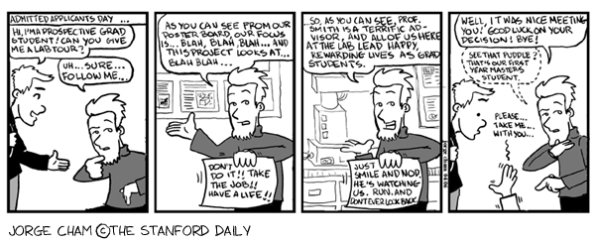
Part I: Going to grad school
You can’t drop out if you don’t go!
Notes:
Go to grad school! -- you can't drop out if you don't go.
Some people defeat their failure at gradschool pre-emptively by asking themselves, "do I need to go to grad school to do what I want with my life?". Do not be like these people (hi __contingent__)!
Even better if you decide to go to grad school because academia is what you've known all your life, so you end up there because you can't think of anything else to do.
Go to the same grad school that you went to for undergrad! You don't need networking! (Not applicable to Carleton College students, but good advice nonetheless.)
Also, don't bother to take time off between undergrad and grad school.
Don't ask any hard questions about placement rates.
Finally, go to a school which is not a good fit for you. Maybe you don't like the location. Maybe the department does your subject (Math is Math everywhere!) but not your specialty -- best is if it specializes in something you hate.

Slide 7
Make grad school the goal
Academia is what you’ve known all your life!
Go with what seems comfortable and familiar!
Don’t look at your life goals and ask if they’re achievable without grad school.
Never take time off!
Wasting the freedom of your early 20s while failing at grad school scores you double.
Notes:
Some people defeat their failure at gradschool pre-emptively by asking themselves, "do I need to go to grad school to do what I want with my life?". Do not be like these people (hi __contingent__)!
Even better if you decide to go to grad school because academia is what you've known all your life, so you end up there because you can't think of anything else to do.
Also, don't bother to take time off between undergrad and grad school.

Slide 8
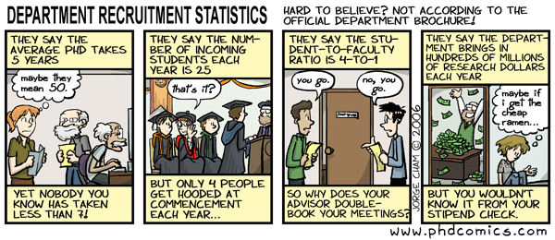
Choose your school carefully
Don’t ask hard questions about placement rates or funding opportunities.
Go to a school which is a bad fit for you.
“Math is Math everywhere!”
Notes:
Go to the same grad school that you went to for undergrad! You don't need networking! (Not applicable to Carleton College students, but good advice nonetheless.)
Don't ask any hard questions about placement rates.
Finally, go to a school which is not a good fit for you. Maybe you don't like the location. Maybe the department does your subject (Math is Math everywhere!) but not your specialty -- best is if it specializes in something you hate.

Slide 9
Part II: Funding
Notes:
Funding Take out lots of loans, or better yet, live off credit cards.
Work a low-paying job that doesn't give you any time to study. Waiting tables is a good one -- works so well for aspiring actors in Hollywood
If you get a job as a TA, make that more important than your own research.
Accept funding from an agency which has a rigid requirement for your plan of study and research, when it turns out you're not as interested in that area as you'd thought.
Live above your means. Don't ask about subsidized housing; don't get a roommate; don't live in a co-op -- get an expensive single apartment.
Never ask for feedback from your advisor or department about why your funding proposals are unsuccessful, because that might mean you improve them enough to get funding. If you do ask for feedback, by all means don't insist they give it to you.

Slide 10
Self-funding
Take out loans
Even better – live off credit cards!
Wait tables or do some other low-paying job
Live above your means
Get an expensive single apartment
Eat out regularly
Notes:
Funding Take out lots of loans, or better yet, live off credit cards.
Work a low-paying job that doesn't give you any time to study. Waiting tables is a good one -- works so well for aspiring actors in Hollywood
Live above your means. Don't ask about subsidized housing; don't get a roommate; don't live in a co-op -- get an expensive single apartment.

Slide 11
Departmental funding
Take your job as a TA more seriously than your own research
Get funding from an agency with a rigid agenda
Never ask for feedback on why your funding proposals are unsuccessful
Notes:
If you get a job as a TA, make that more important than your own research. (Kate, Curtis)
Accept funding from an agency which has a rigid requirement for your plan of study and research, when it turns out you're not as interested in that area as you'd thought. (me)
Never ask for feedback from your advisor or department about why your funding proposals are unsuccessful, because that might mean you improve them enough to get funding. If you do ask for feedback, by all means don't insist they give it to you. (Kate)

Slide 12
Part III: Administrivia and Politicking
Notes:
Administrivia and Politicking
Alienate the department secretary. They're the single most key player in getting anything done in the department; having them against you will be like tossing sand in your car's engine block.
Go to a school with cut-throat competition. Just ask Jeff Ondich how much he liked Berkeley!
"Academic fights are more brutal than our fights in the real world," Henry Kissinger famously observed, "because the stakes are so low." Ignore department politics, so people can stab you in the back at opportune times.
Don't associate with the postdocs; they're still enthusiastic.
Don't network outside your department. Cross-fertilization might lead to new and valuable insights.
Similarly, don't take advantage of your summers to do internships.
Dawdle around getting your boxes checked. There's nothing like trying to do diss research while worrying about the oral exam you should have finished in your second year.
It helps to avoid finding people who will hold you accountable for making progress.

Slide 13
Administration
Alienate the department secretary
Go to a school with cut-throat competition
Ask Jeff Ondich how well he liked Berkeley!
“Academic fights are more brutal than our fights in the real world because the stakes are so low.” – Henry Kissinger
Notes:
Alienate the department secretary. They're the single most key player in getting anything done in the department; having them against you will be like tossing sand in your car's engine block.
Go to a school with cut-throat competition. Just ask Jeff Ondich how much he liked Berkeley!
"Academic fights are more brutal than our fights in the real world," Henry Kissinger famously observed, "because the stakes are so low." Ignore department politics, so people can stab you in the back at opportune times.

Slide 14
Colleagues
Don’t associate with the post-docs – they still have enthusiasm
Don’t network outside your department
Don’t take advantage of the long summers to do internships elsewhere
Notes:
Don't associate with the postdocs; they're still enthusiastic.
Don't network outside your department. Cross-fertilization might lead to new and valuable insights.
Similarly, don't take advantage of your summers to do internships.

Slide 15
Part IV: Coursework
Notes:
Coursework
Take your coursework extremely seriously. Success in grad school means successful research. A laser-like focus on getting unneccessary As will help you fail.
Take lots of electives. Electives distract you from research!
Take hard electives. Going with something easy like an undergraduate language class is a cop-out. Take a difficult course with no possible application to your field of study and spend a lot of time on it.
Treat grad school like it was liberal arts college! Noodle around outside your field because it looks like fun.
Take lots of courses at once. This means you won't have time for things like prepping for orals, finding an advisor, or research.
Incompletes are a time-bomb of failure, so get a bunch of them if possible. If you can't finish the work while you've got dedicated class time for it, you'll for sure not be able to finish the work when you're focused on other classes or research. Bonus if you go to a school where incompletes turn into Fs after a year.

Slide 16
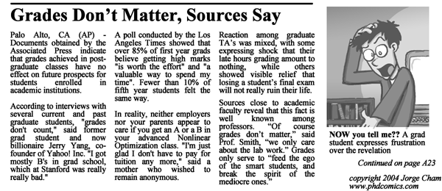
Grad school ≠ Carleton
Notes:
Treat grad school like it was liberal arts college! Noodle around outside your field because it looks like fun.
Take your coursework extremely seriously. Success in grad school means successful research. A laser-like focus on getting unneccessary As will help you fail.
Take lots of electives. Electives distract you from research!

Slide 17
More helpful coursework tips
Take difficult electives
Personal favorite: Classical Japanese!
Take lots of courses at once
“Lots” > 4 (first year), 3 (subsequent years)
Personal record: 5
Incompletes are a time bomb of failure – get as many as possible.
Notes:
Take hard electives. Going with something easy like an undergraduate language class is a cop-out. Take a difficult course with no possible application to your field of study and spend a lot of time on it.
Take lots of courses at once. This means you won't have time for things like prepping for orals, finding an advisor, or research.
Incompletes are a time-bomb of failure, so get a bunch of them if possible. If you can't finish the work while you've got dedicated class time for it, you'll for sure not be able to finish the work when you're focused on other classes or research. Bonus if you go to a school where incompletes turn into Fs after a year.

Slide 18
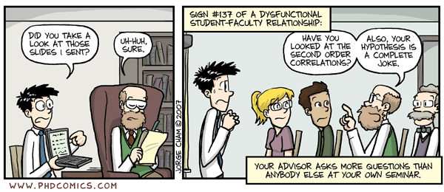
Part V: Your Advisor
Notes:
Choosing an advisor
Pick a bad advisor. These can take many forms -- you don't need to go for the absolute worst advisor, just one that is bad for you can do wonders.
An advisor who is negative and snide about other people behind their backs is well worth consideration. If they're negative about other people, they'll be negative about you, too.
Especially helpful is an advisor who is a poser (you'll be on your own), or who has no networking skills (you'll constantly worry about funding).
If you can, pick a big-name professor whose reputation is already established -- they don't care if you make it or not.
DON'T pick an up-and-coming assistant professor. They can't let you fail, because graduating students is important for their tenure bid.
Sleep with your advisor. That always leads to a nightmare of drama and stress.

Slide 19
Tips for choosing an advisor
Pick a bad advisor
Doesn’t have to be the worst – one that is bad for you will do wonders
Negative and snide people make great advisors
See if you can find a poser, or someone with no networking skills
Notes:
Pick a bad advisor. These can take many forms -- you don't need to go for the absolute worst advisor, just one that is bad for you can do wonders.
An advisor who is negative and snide about other people behind their backs is well worth consideration. If they're negative about other people, they'll be negative about you, too.
Especially helpful is an advisor who is a poser (you'll be on your own), or who has no networking skills (you'll constantly worry about funding).

Slide 20
Reputation is everything
Work with a big-name professor whose reputation is established
Snub the up-and-coming assistant professors
They can’t let you fail
Sleep with your advisor
Great for a nightmare of drama and stress!
Notes:
If you can, pick a big-name professor whose reputation is already established -- they don't care if you make it or not.
DON'T pick an up-and-coming assistant professor. They can't let you fail, because graduating students is important for their tenure bid.
Sleep with your advisor. That always leads to a nightmare of drama and stress.

Slide 21
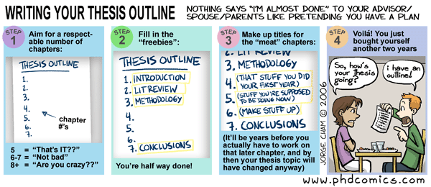
Part VI: Botching your Research
Notes:
Botch your research.
Dither about your topic. Change it once or twice. Or three times.
End up working on a topic you don't care about, or hate. Allow this to defeat your progress.
Don't write any intermediate papers, or present at any conferences. Who knows -- if you did those things it might lead to a chapter in a dissertation.
Don't keep a bibliography. One of the most impressive things I saw at grad school was a student (hi andrel!) who kept meticulous notes on every article he read and every presentation he went to. However, failure is best enabled if you can't remember anything you read or see.
Assent to all the stupid decisions forced on you by advisors or committee members.
If you can manage to get deeply involved with a political or social cause that has nothing to do with your grad school research, do so. Volunteering for a political campaign is good. Taking a leadership role in a vicious unionization fight is good. Doing crisis counseling on weeknights is good. Use your imagination here.

Slide 22
Your topic
Dither about it. Change it … three times.
Work on something you don’t care about
Work on something you hate
Don’t write intermediate papers or give conference talks
Assent to all the stupid decisions your advisor and committee force on you.
Notes:
Dither about your topic. Change it once or twice. Or three times.
End up working on a topic you don't care about, or hate. Allow this to defeat your progress.
Don't write any intermediate papers, or present at any conferences. Who knows -- if you did those things it might lead to a chapter in a dissertation.
Assent to all the stupid decisions forced on you by advisors or committee members.

Slide 23
Lose the focus
Don’t keep a bibliography
Get involved!
With politics!
Crisis counseling on weeknights!
A vicious, unsuccessful unionization fight!
Use your imagination here…
Notes:
Don't keep a bibliography. One of the most impressive things I saw at grad school was a student (hi andrel!) who kept meticulous notes on every article he read and every presentation he went to. However, failure is best enabled if you can't remember anything you read or see.
If you can manage to get deeply involved with a political or social cause that has nothing to do with your grad school research, do so. Volunteering for a political campaign is good. Taking a leadership role in a vicious unionization fight is good. Doing crisis counseling on weeknights is good. Use your imagination here.

Slide 24
Part VII: Insane Mind in Unsound Body
Notes:
Insane mind in unsound body
Leave your major depression untreated. This will make all the other suggestions easier.
Don't get counseling.
Don't take advantage of the support your friends offer you.
Better yet -- don't have any friends at all. Resist all bonding in your first year.
In fact, the best thing is to go it alone! Cultivate a paranoid attitude -- offers of help and concern are probably just traps. (And if you took my earlier advice and went to a cut-throat program, this paranoia is probably justified...)
Don't do any physical activity and don't do any extracurricular activities. This is easier than it sounds -- if you ignore my advice about blowing off research, you might end up spending lots of time at it. Not taking time out to unwind is a great way to blow your top.
NEVER see a doctor. This means you're liable to treat minor illnesses as if they were major (stopping you from working) or that you're liable to ignore them until they become major (also stopping you from working). Seeing a doctor regularly would give you a sanity check on how your body's doing.

Slide 25
Routine maintenance
Don’t do any physical activity
Don’t do any extracurricular activity
Never see a doctor
Treat minor illnesses as if they were major
Ignore major illnesses as if they were minor
Notes:
Don't do any physical activity and don't do any extracurricular activities. This is easier than it sounds -- if you ignore my advice about blowing off research, you might end up spending lots of time at it. Not taking time out to unwind is a great way to blow your top.
NEVER see a doctor. This means you're liable to treat minor illnesses as if they were major (stopping you from working) or that you're liable to ignore them until they become major (also stopping you from working). Seeing a doctor regularly would give you a sanity check on how your body's doing.

Slide 26
Mental health
Leave your major depression untreated
Don’t get counseling (individual or group)
Don’t take advantage of support your friends offer you
Better yet – don’t have any friends at all!
Notes:
Insane mind in unsound body
Leave your major depression untreated. This will make all the other suggestions easier.
Don't get counseling.
Don't take advantage of the support your friends offer you.
Better yet -- don't have any friends at all. Resist all bonding in your first year.

Slide 27
Most important …
Go it alone
Notes:
In fact, the best thing is to go it alone! Cultivate a paranoid attitude -- offers of help and concern are probably just traps. (And if you took my earlier advice and went to a cut-throat program, this paranoia is probably justified...)

Slide 28
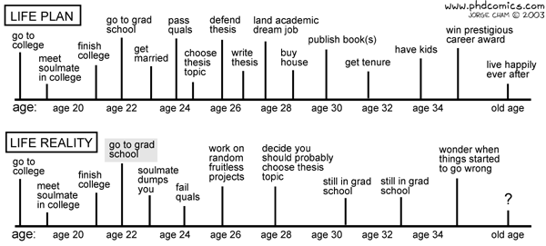
Part VIII: Fallacy of Sunk Costs
Notes:
Fallacy of sunk costs
Kid yourself about how well you're doing.
Ignore signs that you really ought to bail. (ANL anecdote here.)
Don't make an escape plan! The best failure is to be kicked out rather than exit on your own terms.
Don't bother picking up the M.A. on your way out the door. It's a more perfect failure if you have no paper at all to show for it.
Burn all your bridges as you leave. And poison the wells, too.
Sink so much of your self-esteem into grad school that your failure destroys your life for three or four years.

Slide 29
From personal experience
Kid yourself about how well you’re doing
You’re fully funded – you must be doing great!
Ignore the signs that actually, you really don’t belong in grad school
You’re fully funded – you must be meant for grad school!
Notes:
Kid yourself about how well you're doing.
Ignore signs that you really ought to bail. (ANL anecdote here.)

Slide 30
Trapped
Don’t make an escape plan
Better kicked out than a graceful exit on your own terms
Don’t pick up the MA on the way out the door
Burn all your bridges
Poison all the wells, too
Calibrate your self-worth on your failure at academia
Notes:
Don't make an escape plan! The best failure is to be kicked out rather than exit on your own terms.
Don't bother picking up the M.A. on your way out the door. It's a more perfect failure if you have no paper at all to show for it.
Burn all your bridges as you leave. And poison the wells, too.

Slide 31
How to Fail at Grad School
John S. Costello
B.A., Carleton ’95
Drop-out, University of Arizona ’04

Slide 32
How to Fail at Grad School
John S. Costello
B.A., Carleton ’95
> M.S., University of Arizona ’99
Drop-out, University of Arizona ’04

Slide 33
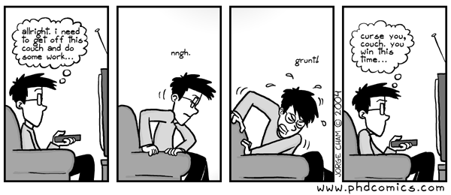
Miscellanea
Notes:
Your failure strategies for Carleton are just as valid in grad school. Don't forget about them! Procrastinate, don't do readings, don't communicate with professors, drink lots, don't get enough sleep ... whatever works for you now -- don't change a thing.

Slide 34
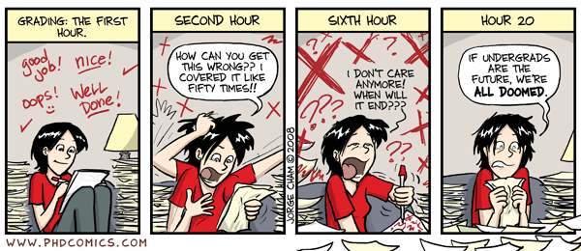
Your sense of irony
Imagine that Jorge Cham's comic Ph.D. is just a bunch of funny jokes.
Imagine that this talk is just a bunch of funny jokes.
Notes:
Imagine that Jorge Cham's comic Ph.D. is just a bunch of funny jokes.
Imagine that this talk is just a bunch of funny jokes.

Slide 35
In conclusion …
Successful grad students can’t avoid everything I’ve talked about.
If you’re only doing a couple things on the list, you’re not trying hard enough.
To ensure failure, do as many as possible!
Even the best and brightest drop out! Failure is not just for losers!
Notes:
Even successful grad students can't avoid everything on this list. If you only end up doing a couple of these things, you're not working hard enough at failing. To really be sure of failure, do as many as possible.
And always remember -- anyone can fail at grad school! Even the best and brightest drop out; failure is not just for losers!

Slide 36
The Happy(?) Ending

Slide 37
Question & Answer
These slides are available at http://joxn.org/fail
Please pick up “The Last Slide” on your way out.

Slide 38
The Last Slide: Best wishes!
Really ask: do you need to go to grad school?
(If “Yes”, would a Master’s degree be sufficient?)
Take time off before you go!
Have a hobby – preferably something physical, with defined time boundaries.
Get treatment (therapy, drugs) for depression!
Get your coursework, qualifying exams, language requirements, Master’s requirements, and other academic requirements out of the way as quickly as humanly possible.
Keep a laser-like focus on the goal: Grad school is not liberal arts college. The goal is to do enough original research to write some papers and a dissertation so you can get the hell out.
Carleton prepares you well for this – you’ll do great!

